Slide 1
Let’s talk about AIB

Slide 2
Acronyms. Lots of them
Azure Image Builder (AIB)
Build templates from the marketplace and customize them
Shared Image Gallery (SIG)
A solution to store and structure your Images.
Windows Virtual Desktop (WVD)
It’s RDS as a service and the infrastructure doesn’t cost you a cent… ?

Slide 3
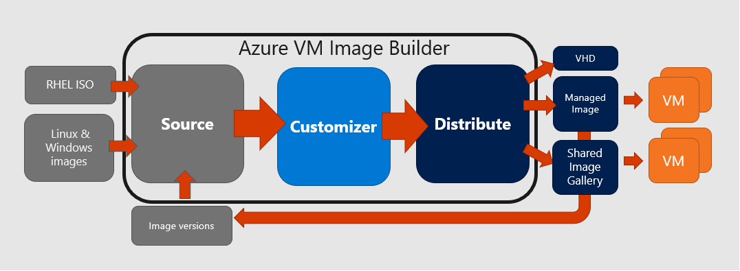
How does AIB work?

Slide 4
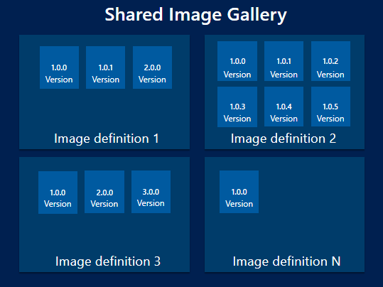
So, uh… What is SIG?

Slide 5
Current Limitations of AIB
Regions are limited to the following:
East US
East US 2
West Central US
West US
West US 2
North Europe
West Europe

Slide 6
Current Limits of SIG
Limits of images per subscription
100 shared image galleries, per subscription, per region
1,000 image definitions, per subscription, per region
10,000 image versions, per subscription, per region
10 image version replicas, per subscription, per region
Any disk attached to the image must be less than or equal to 1TB in size

Slide 7
OK let’s build an image

Slide 8
Light Reading
Azure Image Builder
https://docs.microsoft.com/en-us/azure/virtual-machines/windows/image-builder-overview
Shared Image Gallery
https://docs.microsoft.com/en-us/azure/virtual-machines/windows/shared-image-galleries
Quickstart Examples
https://github.com/danielsollondon/azvmimagebuilder/tree/master/quickquickstarts
My PowerShell Module
https://www.powershellgallery.com/packages/az.imagebuilder.tools/1.0.0.1
My PowerShell Module
https://github.com/tabs-not-spaces/az.imagebuilder.tools
Preview AIB module
https://www.powershellgallery.com/packages/az.imagebuilder

